Slide 1
The 2024 IUCN Red List update for birds
Dr Ian Burfield
Global Science Coordinator (Species)
Bird Red List Authority Coordinator

Slide 2
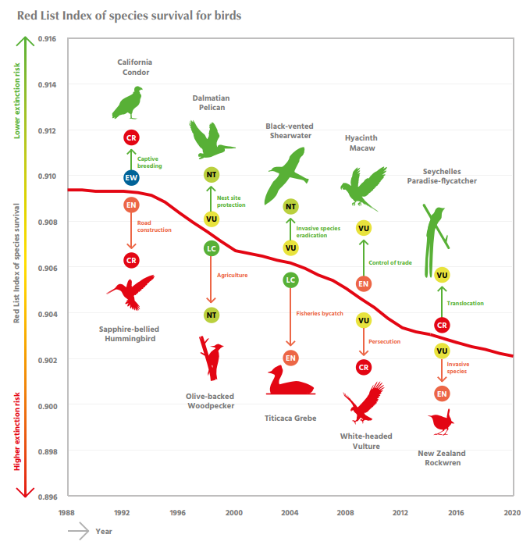
BirdLife is the global Red List Authority for birds
Responsible for evaluating all of the world’s c. 11,000 bird species against the IUCN Red List categories and criteria.
Currently completing 8th comprehensive assessment for birds. Other than mammals (three assessments), no other group has been assessed more than twice.
Repeated reassessment is crucial for input to global biodiversity policy through underpinning the Red List Index.

Slide 3
BirdLife International Red List Team
Rob Martin
Alex Berryman
Jemma Vine
Claire Rutherford
Euan Chad
Lachlan Richardson
Ian Burfield
Red List Authority Coordinator
IMAGE: FRANCIS J. TAYLOR

Slide 5
2024 Red List update for birds
4,742 species reassessed (42% of all birds globally)
>4,300 Least Concern species, bulk-updated using newly available information sources (screened to identify potentially Threatened or Near Threatened species), including:
Global Forest Watch (population trends inferred from remotely-sensed changes in tree cover within the distributional ranges of forest-dependent bird species)
European Red List of Birds
Action Plan for Australian Birds
Partners in Flight Avian Conservation Assessment Database (North America)
Waterbird Populations Portal
>400 Threatened or Near Threatened species, updated manually using latest data and info from scientific literature, monitoring schemes, BirdLife Partners, species experts, etc.
145 species reassessed in different Red List categories, following transparent expert consultation on BirdLife’s web-based discussion Forums (https://forums.birdlife.org/)
IMAGE: FRANCIS J. TAYLOR
IMAGE: FRANCIS J. TAYLOR

Slide 6
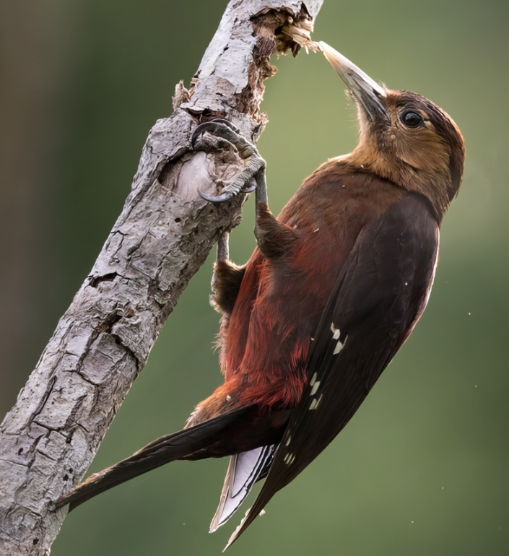
101 species downlisted to lower threat categories
Only 7 due to genuine improvement
Rest due to better knowledge – e.g. many Amazonian species have not declined as much as feared 10–15 years ago, because deforestation has not been as severe as projected.
Example of genuine improvement:
Okinawa Woodpecker
Endemic to Okinawa island
Was Critically Endangered – now Endangered
Was declining due to habitat clearance and predation by invasive Small Indian Mongoose
Threats addressed by forest protection and successful programmes to control invasive mongoose
Population remains small (<400 mature individuals) but is now stable
IMAGE: FRANCIS J. TAYLOR
© Lars Petersson
IMAGE: FRANCIS J. TAYLOR

Slide 7
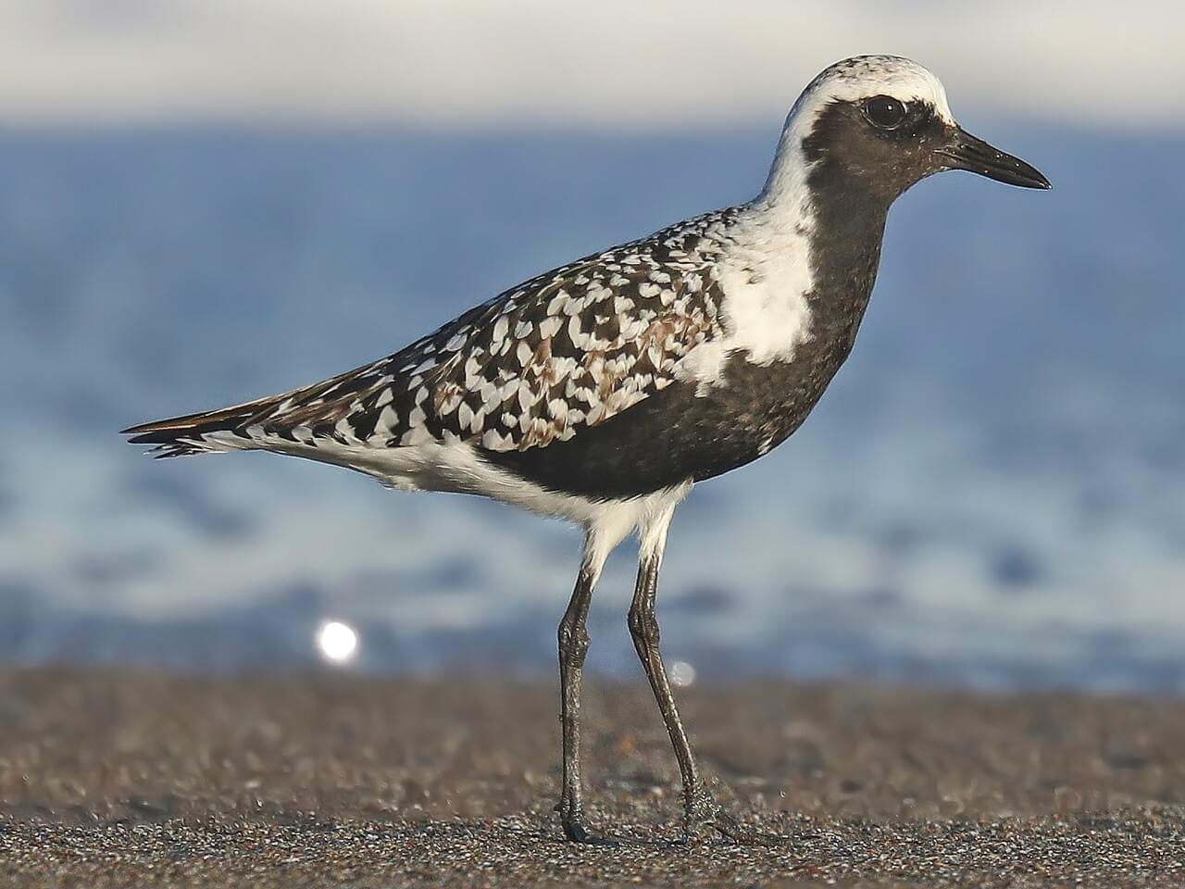
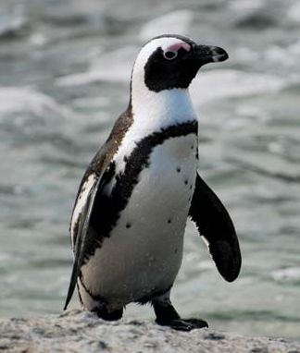
38 species uplisted to higher threat categories
25 due to genuine deterioration
5 species reclassified as Extinct – previously Critically Endangered (Possibly Extinct)
White-chested White-eye
4 Hawaiian honeycreepers
16 migratory shorebirds uplisted to Near Threatened or Vulnerable due to population declines, involving species using all flyways, including East Asian – Australasian Flyway:
Grey Plover (photo)
Ruddy Turnstone
Broad-billed Sandpiper
Curlew Sandpiper
Dunlin
African Penguin
Was Endangered
Now Critically Endangered
© Matt Davis
IMAGE: FRANCIS J. TAYLOR
© Paul Mannix
IMAGE: FRANCIS J. TAYLOR

Slide 8
Next steps and future plans
Monday 28 October
2024 Red List update officially published at the 16th Conference of the Parties to the UN CBD (Convention on Biological Diversity) in Colombia.
Then available at https://datazone.birdlife.org
November 2024 to July 2025
Complete 8th comprehensive bird assessment.
Update Red List Index with changes 2020–2024.
Publish results at IUCN World Conservation Congress in Abu Dhabi (October 2025).
2025–2029
Undertake 9th comprehensive bird assessment.
Update Red List Index with changes 2024-2028.
Measure progress towards 2030 CBD targets.
Grateful thanks to the Japan Fund for Science and Gala Dinner guests for generously supporting BirdLife International’s Red List work
redlistteam@birdlife.org
https://forums.birdlife.org
IMAGE: FRANCIS J. TAYLOR

